Slide 1

LITARATURE SURVEY

Slide 2
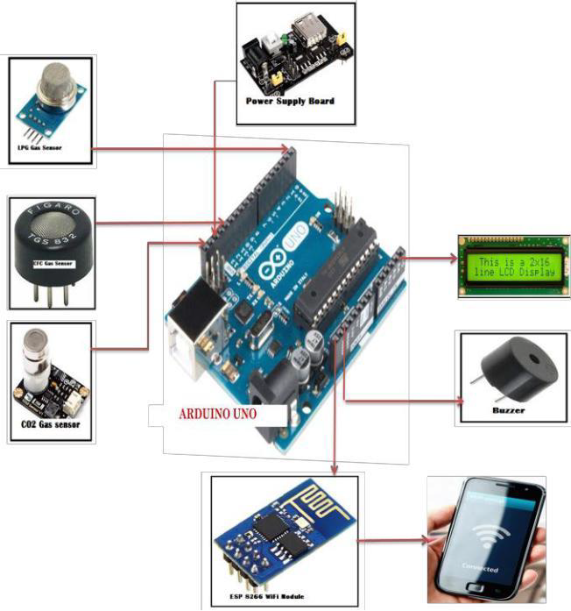
TITLE: GAS LEAKAGE DETECTION AND ALERTING SYSTEM USING IOT FOR HOME AND INDUSTRIAL SAFETY
SOURCE : https://ijcrt.org/papers/IJCRT2009123
AUTHORS : R.SUDHA ,S.ARUN PRASAD
In this study, we employ the MQ-6 semiconductor sensor to find flammable gas. This gas sensor is constructed of sulphur nitride. In clean air, this sensor's conductivity is reduced. The output of this sensing component then decreases. The microprocessor keeps track of this weak signal, and it uses it to determine when to start releasing gas. The microcontroller currently activates the LED and buzzer.After a brief delay, it also turns on a fan to expel gas and keeps sending texts to your mobile number with the subject "GAS LEAKAGE.“This paper aims to provide a solution to this problem by building a device that utilizing sensors connected to Node MCU. The device performs area monitoring continuously. The gas sensor provides data to Node MCU, and then the results are displayed as a warning to the user via an Android-based smart-phone device
.

Slide 3
TITLE : Gas leakage detection and alerting system using Arduino Uno SOURCE:https://www.researchgate.net/publication/347495607_Gas_leakage_detection AUTHORS: Syeda Bushra Shahewaz and Ch. Rajendra Prasad
In this paper the authors introduced GSM based gas leakage detection system, in which the GSM module is introduced for wireless alert and gas leakage detection, efficiently implemented. Arduino UNO (Atmega-328) is the main unit of the system which performs the following tasks. A signal conditioning of the Arduino UNO is done by output signal of the sensor, provided input to Arduino. The detection results displayed on LCD. Indicates the people of danger in work place, factory, home. Buzzer activity with beep(siren) sound is made. Also send alert SMS to the in charge of the plant whose number is saved in SIM card by using GSM modem. The SMS received depends upon the leak of gas in the detection area of the sensor

Slide 4
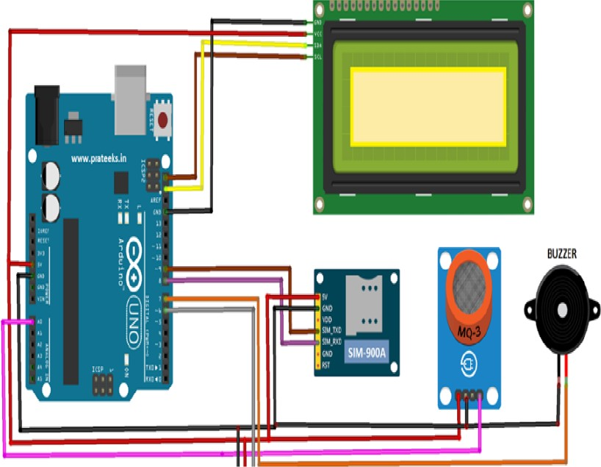
TITLE : GAS LEAKAGE DETECTOR AND MONITORING SYSTEM SOURCE : https://www.Researchgate.Net/publication/361562550 AUTHORS : YEKINI N. ASAFE,ADIGUN J.OYERANMI,OLOYEDE
The system in this study is based on a microcontroller and includes a buzzer, an LCD display, a GSM module, and a gas sensor. The system uses an Arduino microcontroller, a buzzer, and a MQ2 gas sensor to monitor gas leaks and send SMS notifications as necessary. The circuit includes a buzzer, LCD display, GSM module, and Microcontroller MQ2 gas sensor. When the sensor detects a gas leak, it sends the information to the microcontroller, which then makes a decision and sends a warning message to the user as an SMS to a mobile phone so that the user can take the appropriate action.

Slide 5
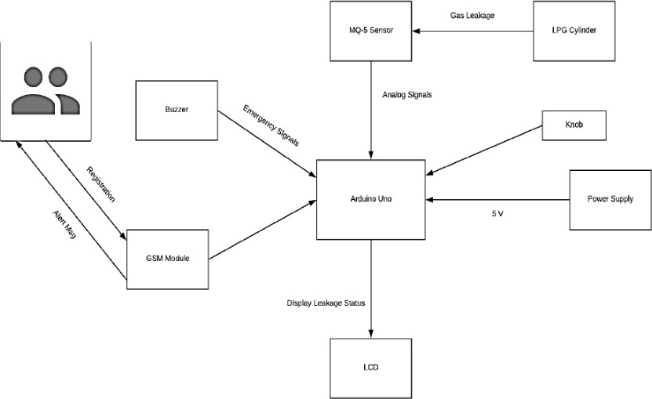
TITLE: DESIGN OF A SMART GAS DETECTION SYSTEM IN AREAS OF NATURAL GAS STORAGE SOURCE: https://ieeexplore.ieee.org/document/8128365 AUTHORS: ANA M.C.ILIE, CARMELLA VACCARRO
In this study they implemented the Smart Gas Detection system, which is the equipment stated in this paper, can measure the quality of the air and water, including all the parameters that could experience outliers due to a potential gas leak in the groundwater or atmosphere. Low cost sensors can monitor the gases CH 4 and CO2 in the air and the temperatures, pH levels, and electrical conductivities in the water, respectively. This is implemented using an Arduino UNO microcontroller, which receives data from the sensors and transmits it to a database running on a Raspberry Pi 3..

Slide 6


